Slide 1
Edge AI for Net-Zero
Team: esworkingshoppers

Slide 2
Done | Phase | Checklist item
[o] | 1. Problem Understanding & Research | Understand the problem domain
[o] |  | Conduct preliminary research
[ ] |  | Formulate a clear problem statement
[ ] |  | Conduct further research based on the finalized problem statement
[o] | 2. Data Preparation & Analysis | Clean and preprocess the available energy-domain data
[o] |  | Perform exploratory data analysis and visualization
[ ] [ ] |  | Water-domain data will be provided at a later stage After API is provided, will create ingestion pipeline for live updates
[o] | 3. Baseline Model Development | Develop a basic model for each domain using ML-based regression or deep learning
[o] |  | Train and evaluate the models
[o] |  | Demonstrate the initial results through a basic working demo (live dashboard on the QIDK)
[o] | 4. Edge Deployment (new) | Quantized with Qualcomm AIMET, running on the QIDK’s NPU, verified against the original models

Slide 3
The question: how close is campus to net-zero?
Net deficit = Demand − Solar. Positive: we import from the grid. Negative: surplus to store or export.
Self-sufficiency = Solar ÷ Demand × 100 %
1 hour ahead: real-time decisions (battery ramping, cloud dips) and checking that sensors are telling the truth.
24 hours ahead: planning: how much grid power to buy, when to charge batteries, when to pre-cool.
Why on the edge: the data stays on campus, and nothing waits on a cloud round trip.

Slide 4
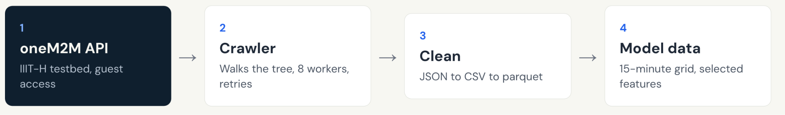
Where the data comes from
A live oneM2M API on the IIIT-H testbed: 1,647 resources crawled across 9 device families (energy, solar, water, air quality and more).
Today we crawl the placeholder server, which has the same schema as the main API (not shared with us yet). Next: replace the one-off crawl with a live poller.

Slide 5
Data Analysis
Prior to any model, the data must be analysed to identify trends, broken data and anomalies.
Initial Steps:
1) Separated data based on version
2) Separated further based on version, and aligned the matching columns to provide continuous information
3) Removed Null Columns and sensors with too much error - further explained next slide.
4) Generated Graphs to get basic understanding of Data
Some fixes:
2 timestamp columns - resolved by picking the correct one
Units not matching - operated on entire column
Operations taking too long - Used parquet for operations, csv for reading clearly. Also created summary reports

Slide 6
Data Auditing
Our data removed:
Dropped 4 non-viable nodes (SB00-01, SL-VN02-00, SL-VN03-00 V1.0.1 and V2.0.1) - frozen values across long stretches of time.
Fixed inverted meter wiring on SL-PL00-00 (which logged 97.5% negative solar generation) using sign correction.
Unit Standardization: Standardized the inconsistent units into uniform physical Watts (W)
Aligned readings into 15-minute grids with IST cyclic temporal embeddings (sin/cos for hour, day-of-week, and day-of-year).
(Cyclic Temporal Embeddings are a technique used to essentially represent that time is circular rather than saying 23:59 and 00:01 is 24 hours apart, similarly for day of week and day of year).

Slide 7
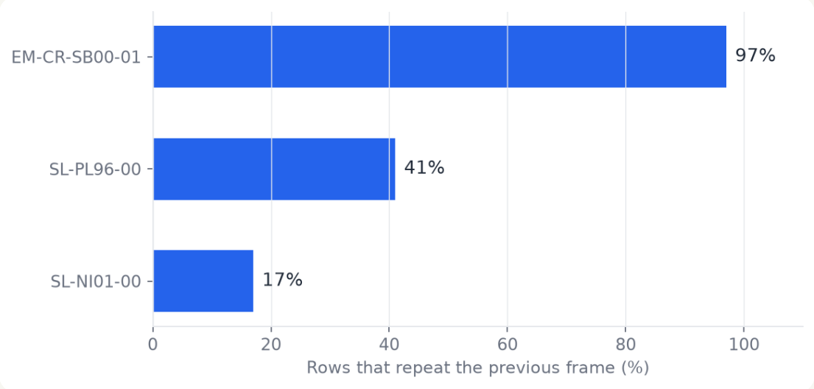
Data quality: some nodes mostly repeat themselves
Other problems we found
Swapped active and reactive power labels on VN95-00
Units and signs differ between meters (W vs kW, import sign)
Sentinel values such as -0.999 and absurd spikes on the substation
Inverters send nothing at night, filled as 0 W

Slide 8
11 sensor nodes feed 58 input features
The nodes
6 solar: three plants and three inverters
2 grid: the substation and the grid incomer
3 room meters: server rooms and sub-meters
The features
58 inputs: 41 electrical readings + 11 “was this value filled in?” flags + 6 time-of-day / week / year signals
Each model reads the last 24 hours: 96 readings, 15 minutes apart
Split in time order, 70 / 15 / 15: the test period is 10 Nov – 31 Dec 2025

Slide 9
Major Features of Solar Sensors
SL-NI03-00 - Solar Inverter Node
DC Solar Tracking: Per-string V, I, P for up to 6 PV arrays.
AC Phase Outputs: 3-phase individual AC outputs and line-to-line voltages (V_{RS}, V_{ST}, V_{TR}).
Yield Metrics: Daily energy (Eac_today), lifetime energy (Eac_total), active power, grid frequency, PF.
SL-VN95-00 — Advanced Grid & Power Quality Meter
  Complete Voltage Matrix: Phase-to-neutral (V_{RN}, V_{YN}, V_{BN}) and phase-to-phase (V_{RY}, V_{YB}, V_{BR}).
  Detailed Currents: Load, active, reactive, and neutral (I_N) line currents.
  Power & Quality Analytics: Active, reactive, and apparent power per phase; 4-quadrant PF; phase angles.
  Bidirectional Energy: Grid frequency, Total Energy Import (TEI), and Export (TEE).

Slide 10
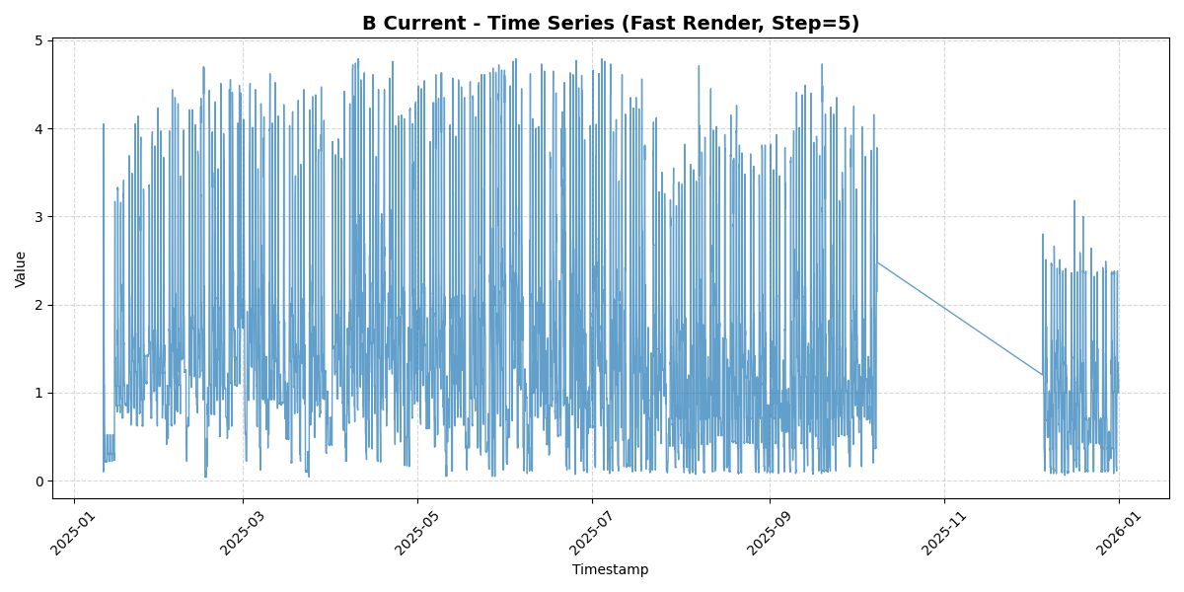
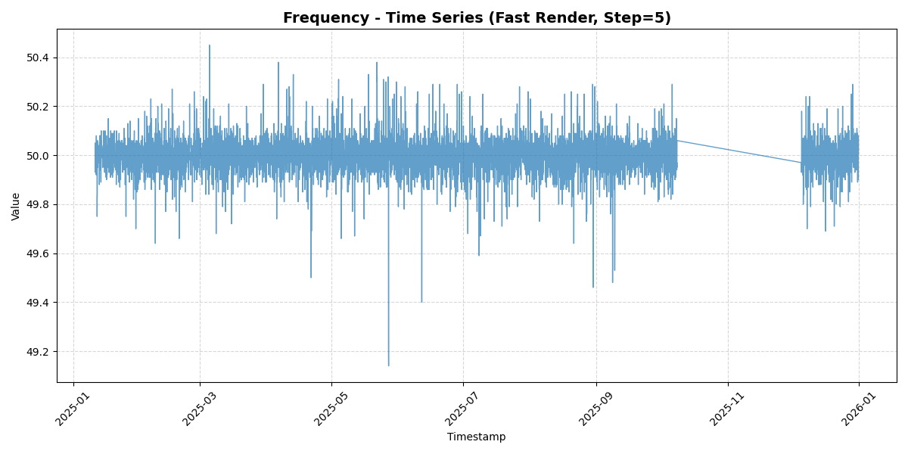
Graphs and Insights
Clearly visible - a clear issue in data in October to December 2025 - EM-CR-KH95

Slide 11
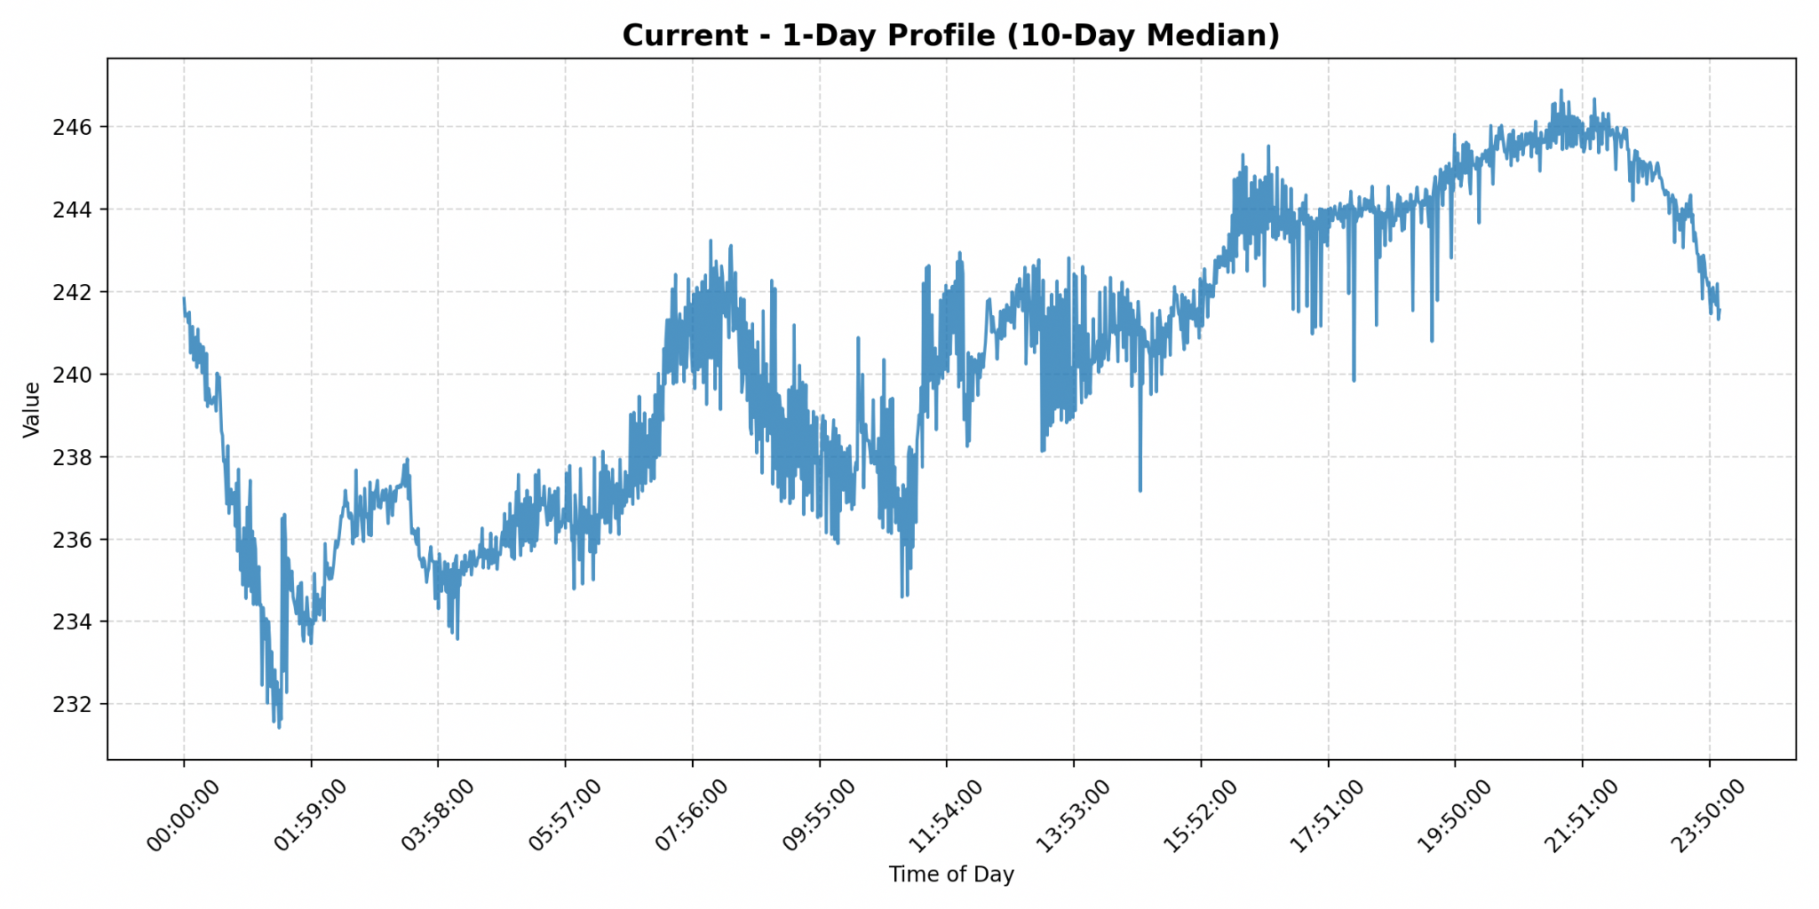
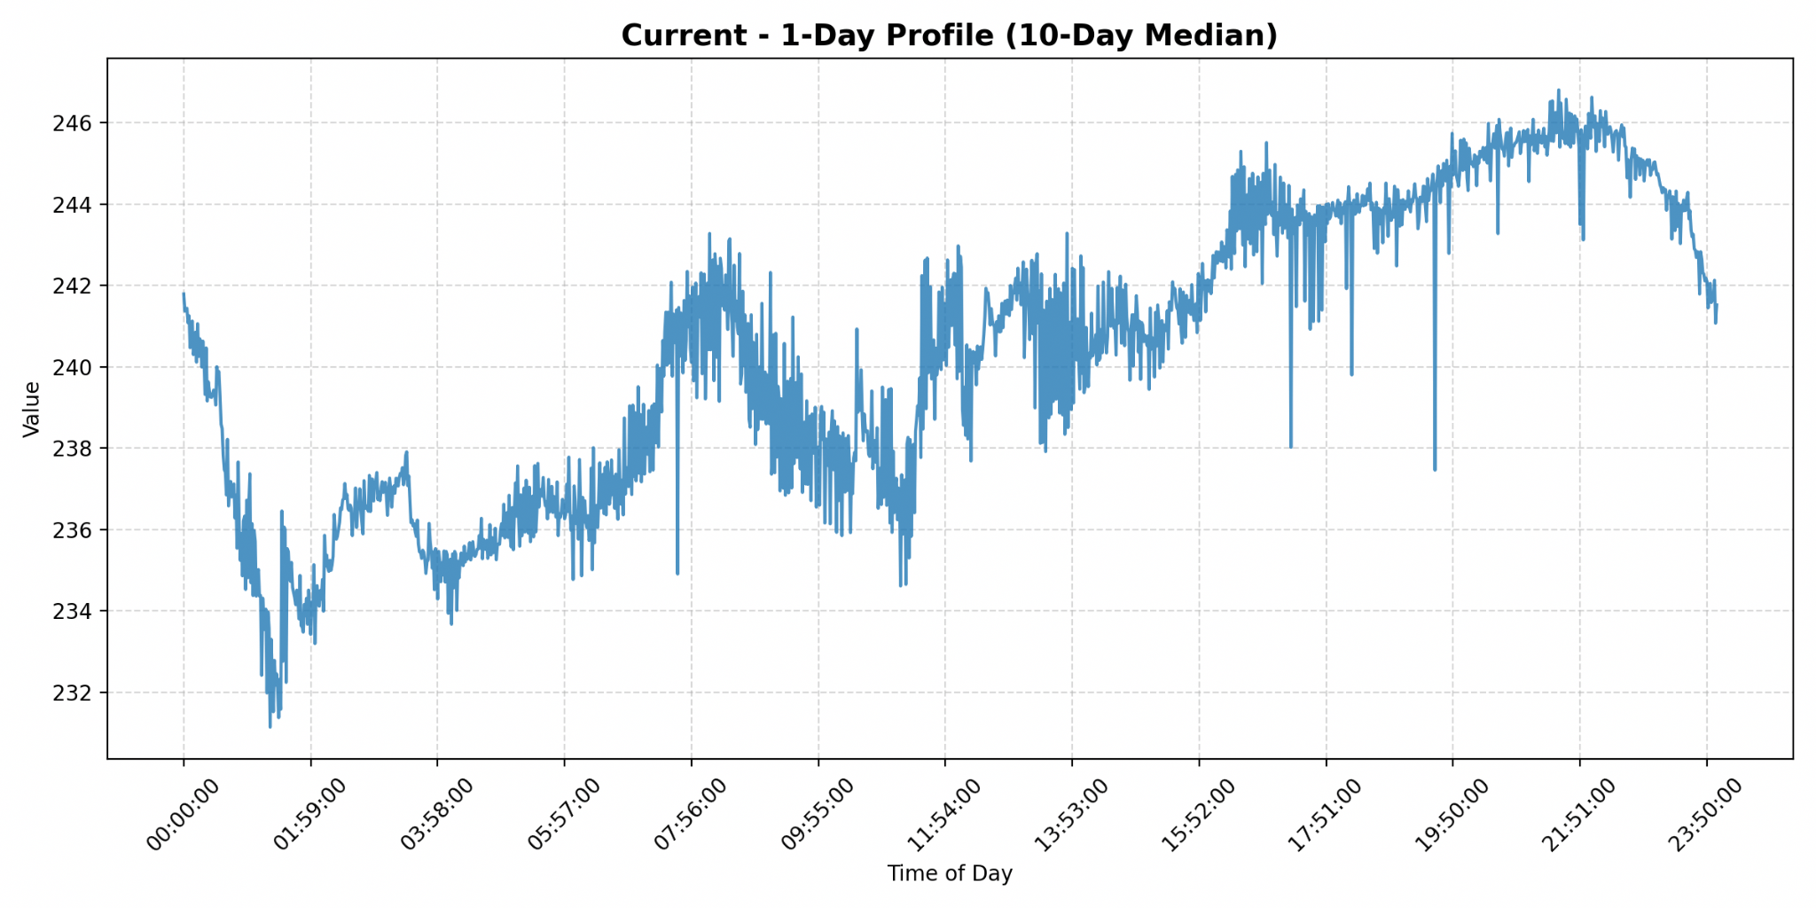
Graphs and Insights
A day in a smart room (SR-EM-KH04-01,02) are almost the same - you can see clear trends of current usage dropping after 12 - 5 AM. The electricity starts being used more often after that.

Slide 12
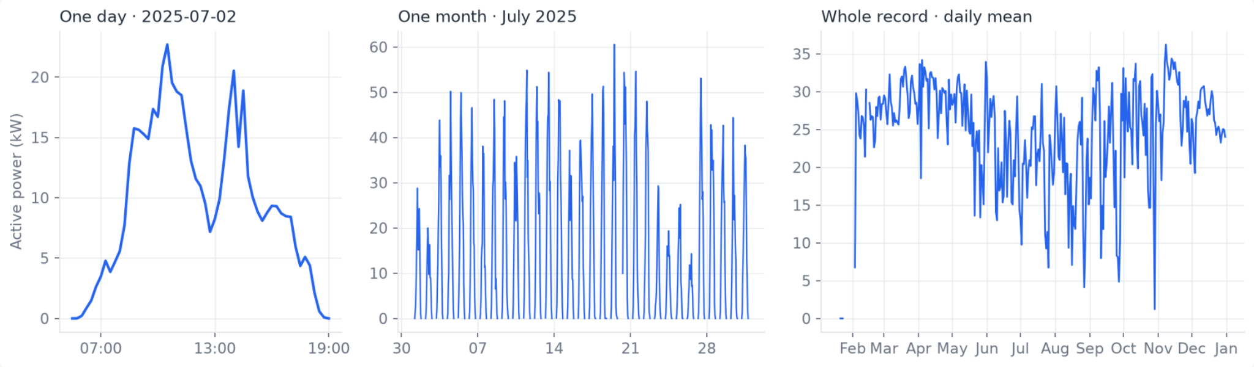
Solar output: a clean daily cycle, shaped by weather
Inverter SL-NI03-00. Output peaks at midday and drops to zero overnight; cloudy days show up as lower peaks
in the monthly view.

Slide 13
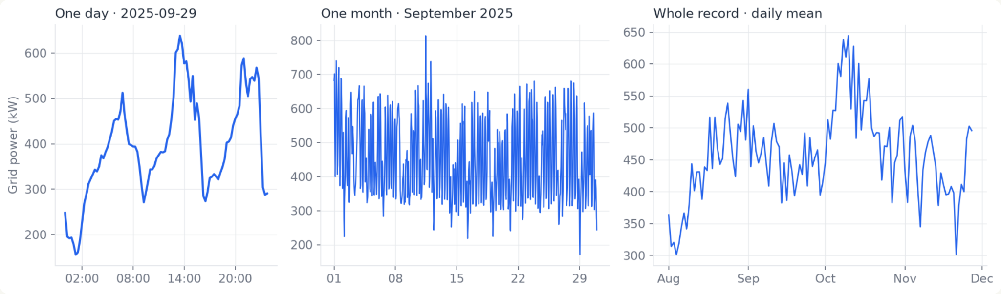
Campus demand: two peaks a day, busiest in October
Substation EM-CR-SB00-00. Daily load swings between roughly 300 and 600 kW, with the highest daily
averages in October. Broken sensor readings were filtered out.

Slide 14
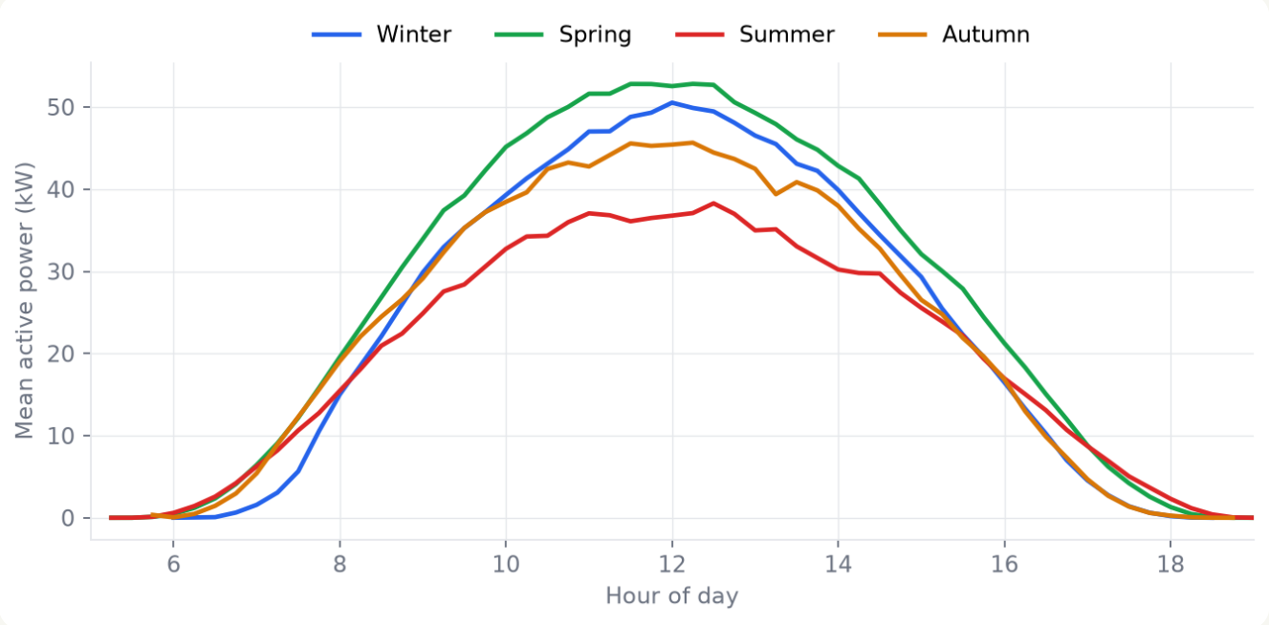
Seasons: spring peaks highest, summer lowest
Spring averages about 53 kW at midday, summer about 37 kW.
Summer may be dragged down by monsoon cloud. Adding weather data, our next step, will confirm it.
A model needs season-aware inputs, which is what the weather and almanac features add.

Slide 15
Models
# | Model | How it works (plain language)
1 | Persistence | "It will be the same as right now." Predicts y(T) = y(now). Very hard to beat 15 minutes ahead, because power changes slowly.
2 | Same time yesterday | Predicts y(T) = y(T - 24 h). Captures the daily cycle. For solar 24 h ahead this is the same as persistence.
3 | Same time last week | Predicts y(T) = y(T - 7 days). Captures the weekly cycle (weekday vs weekend).
4 | Ridge regression | A straight-line (linear) model: the forecast is a weighted sum of recent values, yesterday's and last week's values and the calendar features. "Ridge" adds a penalty on large weights (alpha = 10) so it does not overfit. Inputs are standardised and missing values filled with the median.

Slide 16
5 | LightGBM | Gradient-boosted decision trees: hundreds of small trees, each one correcting the mistakes of the ones before it. It can capture non-linear rules like "if it is 2 pm on a weekday and yesterday was high, expect high". It handles missing values directly. We used up to 800 trees, learning rate 0.05, 31 leaves per tree, and stopped early when the validation error stopped improving. Trained to minimise absolute error (which matches the WAPE score).
6 | LSTM | A neural network for sequences (Long Short-Term Memory). It reads the last 24 hours (96 steps) one step at a time, keeps an internal "memory", and at the end produces forecasts for all three horizons at once. One layer, 64 units, about 25,000 parameters. Trained with an absolute-error loss, AdamW optimiser, up to 20 epochs with early stopping. Missing values are set to 0 with a "was missing" flag.

Slide 17
Forecasting Results
Mean WAPE over 10 nodes (SL-NI01-00 excluded because of poor data quality), Nov-Dec 2025. Lower is better.
Horizon | Persistence | Yesterday | Last week | Ridge | LightGBM | LSTM
15 min ahead | 0.163 | 0.353 | 0.416 | 0.186 | 0.135 | 0.161
1 hour ahead | 0.354 | 0.353 | 0.416 | 0.309 | 0.219 | 0.239
24 hours ahead | 0.353 | 0.353 | 0.417 | 0.391 | 0.297 | 0.303

Slide 18
LightGBM has the lowest average error at every horizon, but the margins are modest. At 15 minutes and 24 hours the LSTM is close behind. At 24 hours the LSTM wins at 2 of 10 nodes (SL-VN95-00, SR-EM-KH04-02).
15 minutes ahead, "same as now" is very hard to beat on the big substation, on EM-CR-KH95-00 and on SR-EM-KH04-00: persistence is as good or better.
Solar 24 hours ahead: "same time yesterday" beats LightGBM at all 5 solar nodes (and wins or ties against every model at 4 of them). Tomorrow's cloud cover is not predictable from past power alone, and we have no weather data. (We tried adding sun-position and neighbouring-node cloud signals in src/08_pv_clearsky.py. They did not beat "yesterday".)
Building loads 24 hours ahead benefit most from models: SR-EM-KH04-01 drops from 0.85 (yesterday) to 0.46, EM-CR-KH95-00 from 0.54 to 0.34, the substation from 0.103 to 0.091.
Against the proposal's target ("beat the best naive forecast by at least 10%"): LightGBM meets it at 6 of 11 nodes at 15 minutes, 8 of 11 at 1 hour and 3 of 11 at 24 hours (LSTM: 4, 6 and 2). Details: results/forecast_h1a.csv.
Why the LSTM does not beat LightGBM. We have not proved the reasons, but the likely ones are:
It sees less history: a 24-hour window, versus LightGBM's explicit values from 2 days and a week ago (loads here are strongly weekly). This is a confirmed difference in the setup.
It is small, trained once per node (one random seed) on about 8 months of data, so small gaps between it and LightGBM are within run-to-run noise.
It has to learn things LightGBM is handed directly, such as "the same time yesterday".
The problem is mostly "recent values + time of day + day of week", which suits tree models, and the test months (Nov-Dec) differ from the training months, which trees tolerate better than neural networks. A fair test would add the week-ago value to the LSTM, run several seeds and try a larger network. We have not done this.

Slide 19
Research Backing
https://www.researchgate.net/publication/399567462_Time-Series_Analysis_of_Sensor_Data_for_Smart_Devices
Demonstrate that LSTMs outperform traditional models (like ARIMA) by naturally capturing the complex non-linearities, non-stationarity, and long-term temporal dependencies inherent in continuous smart device telemetry.
Unlike standard RNNs limited by vanishing gradients, LSTMs use gated memory cells to retain extended multi-hour historical contexts for accurate future load forecasting.
https://link.springer.com/article/10.1007/s00521-023-09398-9
“A predictive analytics framework for sensor data using time series and deep learning techniques”
Benchmark studies on IoT sensor analytics confirm that deep sequential architectures significantly reduce error rates compared to classical statistical forecasting on complex sensor streams.
Shows hybrid CNN-LSTM / TCN approaches provide the closest tracking to real sensor dynamics.

Slide 20
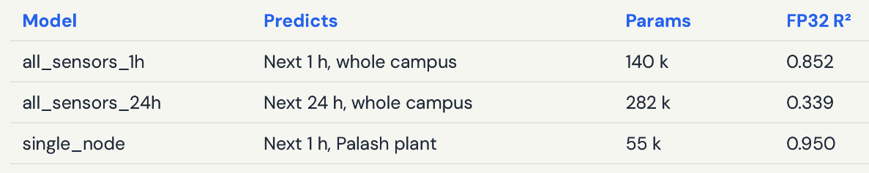
From benchmark to deployment: three LSTMs
These are the models we took onto the Qualcomm board. Each reads the last 24 hours and forecasts the whole horizon in one go. The 1-hour model is the workhorse: it drives both dispatch and fault detection.
R² below averages solar and grid (1 = perfect). Solar alone: 0.94 at 1 h and 0.80 at 24 h. The 24 h model’s weak spot is grid demand, which depends on weather and campus events: exactly what our next iteration adds.

Slide 21
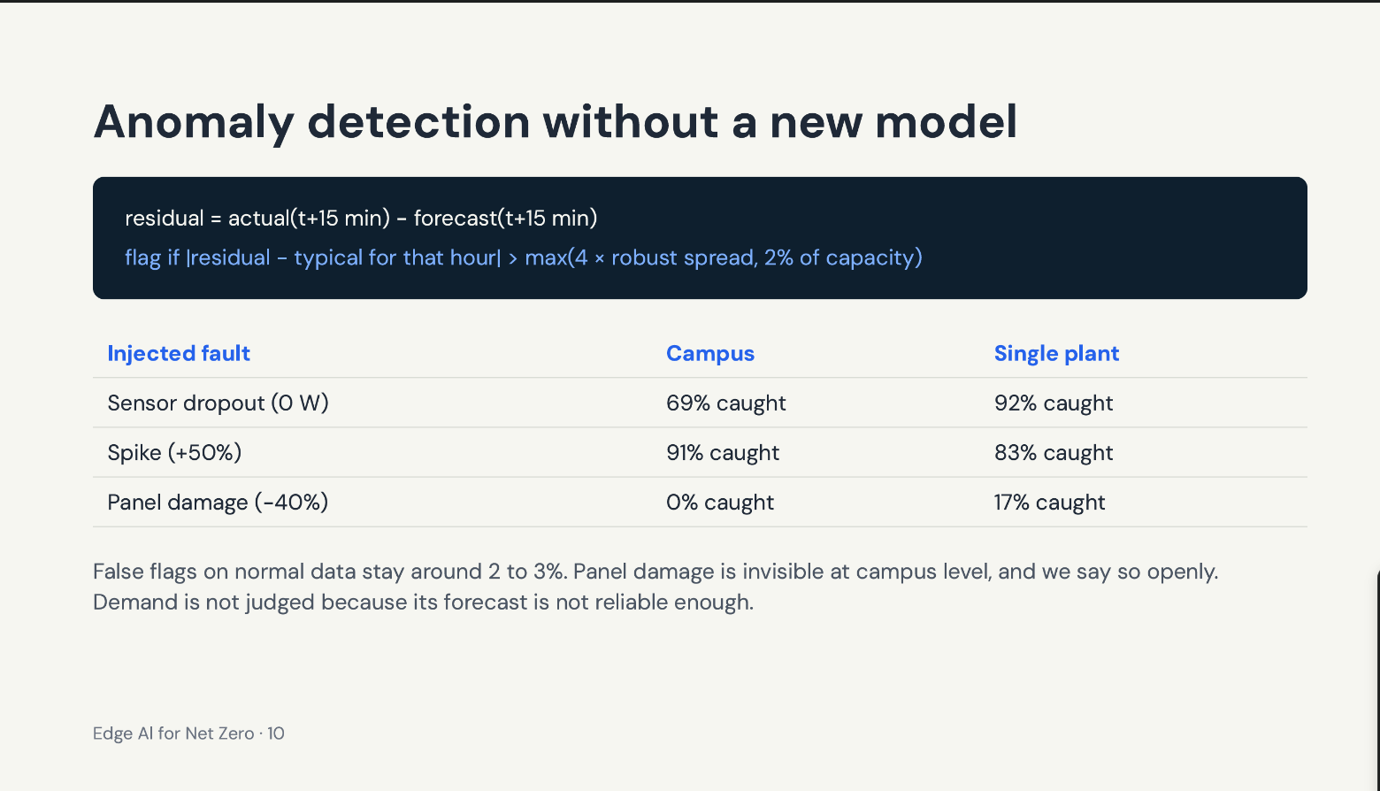

Slide 22
Shrinking the models for the NPU, without retraining
Why: the NPU is fast at integer maths, so we convert the models from 32-bit floats to 8-bit weights. Files get about 4× smaller (153 / 297 / 71 KB).
Why we kept 16 bits inside: an LSTM passes its memory through 96 steps, and small rounding errors pile up. 16-bit activations keep it stable.
The main fix: at first we lost about 20 kW of accuracy. The tool had sized its number ranges from sample data, which never contained some values the model really produces. We set those ranges from the maths instead (an LSTM’s internal state always lies between −1 and +1), and fidelity jumped from 44 to 78 dB.
Tool: Qualcomm AIMET, with the same trained models and no retraining.

Slide 23
On the board: under 4 ms, matching the originals
Model | Time on the NPU | Matches the original | Accuracy (R²) before → after | Same fault verdicts
Campus 1 h | 3.4 ms | 48 dB | 0.852 → 0.853 | 99.7 %
Campus 24 h | 3.4 ms | 46 dB | 0.339 → 0.335 | 99.8 %
One plant | 3.9 ms | 52 dB | 0.950 → 0.950 | 99.9 %
What 48 dB means: on the 1 h model, the board’s answer is never more than 0.45 % of capacity off the original, about ten times smaller than the forecast error itself (≈4 % for 1 h solar).
What 3.4 ms means: new data arrives every 15 minutes, so the board is more than 200,000× faster than it needs to be.
Qualcomm AIMET beat the converter’s own default by 2.6–5.9 dB on every model. Measured on ~4,800 held-out test windows per model.

Slide 24
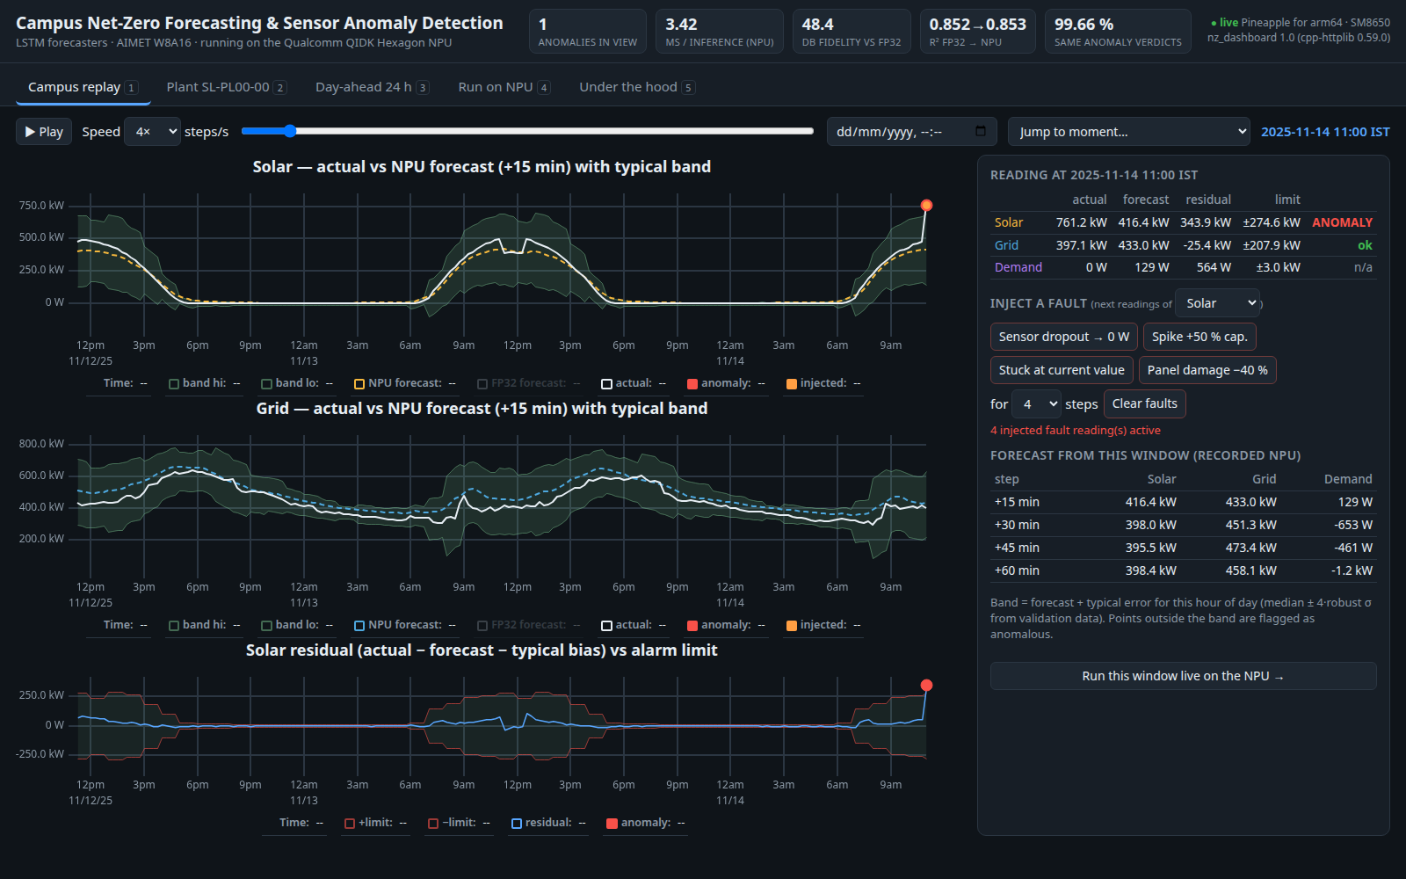
Live demo: the board serves its own dashboard
A small C++ server on the QIDK serves this page and runs the models. No laptop-side compute.
Replay the test period, inject a fault (dropout, spike, stuck sensor, panel damage) and watch it get flagged.
Edit any input or upload a CSV and run it live on the NPU: about 5 ms of compute, 2 s end to end.

Slide 25
What we learned
Test on real hardware. 8-bit everywhere looked fine in simulation (41 dB) but broke on the NPU (15 dB for the 24 h model). Only the on-board test caught it, which is why we ship 16-bit activations.
Let physics set the ranges, not just sample data. That one change took activation fidelity from 44 to 78 dB.
Check what the tool really did. The exporter had hidden the LSTM weights, so they weren’t being shrunk to 8 bits until we fixed it.
Compare like with like. We judge the board against the original model on identical inputs, so our results don’t depend on the rebuilt dataset being perfect.

Slide 26
Done since the proposal, and what’s next
Done since the proposal
Quantized with Qualcomm AIMET: weights about 4× smaller, the 75 % reduction we planned
Running on the QIDK and measured: 3.4–3.9 ms per forecast on the NPU
A working demo, served by the board itself
Next
Weather and cloud-cover data for 24 h solar; campus almanac (semesters, exams, holidays) for demand
NPU-friendly architectures (1-D CNN / TCN) without recurrent bottlenecks
Live ingestion from the node APIs, and battery scheduling (MPC) on top of the forecasts
Other domains (water) once that data arrives

Slide 27
Making the system grow with the campus
Models that keep up. Usage shifts and panels age. Short term: correct the forecasts on the board using recent errors, with no retraining. Longer term: retrain regularly off the board, re-quantize with the same pipeline, and only swap in a new model if it beats the old one.
Weather and campus events affect all of these readings, and they go into our next model iteration.
8-bit everywhere. 16-bit activations work today. Training with quantization in mind (QAT) could make full 8-bit usable too, cutting latency and power. We haven’t tried it yet.
Fault detection for every node, not one. One model per node doesn’t scale: 11 models to train, quantize, monitor and retrain. Instead, one shared model per sensor type (solar, grid, room) runs across all nodes: 3 models however big the campus gets. We’ll also compare plants with each other, since panels under the same sky should agree. That’s how we’d catch the panel damage that campus totals hide.

